Slide 1









Whiteboardmaths.com
7
2
1
5
© 2004 All rights reserved

Slide 2
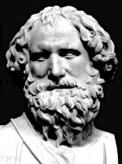
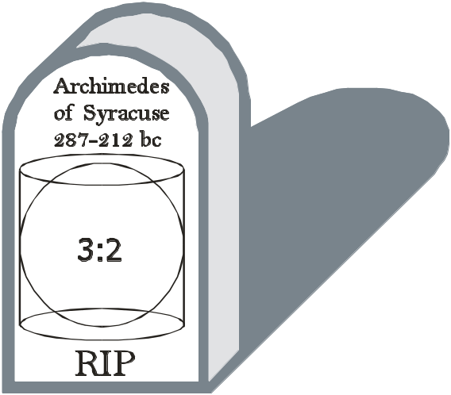

In determining the formulae for the surface area and volume of a sphere, Archimedes discovered the extraordinary fact that if you envelop the sphere perfectly with a cylinder, the cylinder will have both a volume and a surface area that are exactly 1½ times those of the sphere. He was so overjoyed at discovering this remarkable relationship between these shapes that he had them inscribed on his tombstone together with the ratio 3:2.
1. Using the appropriate formulas, establish the truth of this relationship for volume.
Volume of sphere = πr³
Volume of cylinder = πr² x 2r
r
= 2πr³
= 1½ x πr³

Slide 3

In determining the formulae for the surface area and volume of a sphere, Archimedes discovered the extraordinary fact that if you envelop the sphere perfectly with a cylinder, the cylinder will have both a volume and a surface area that are exactly 1½ times those of the sphere. He was so overjoyed at discovering this remarkable relationship between these shapes that he had them inscribed on his tombstone together with the ratio 3:2.
2. Establish the relationship between the two shapes for surface area.
2πr
Surface area of sphere = 4πr²
Surface area of cylinder = πr² + πr² + 2πr x 2r
r
= 2πr² + 4πr²
2r
= 6πr²
= 1½ x 4πr²


Slide 4

Question. Six ball bearings are to be tightly sealed in a hollow metal cylindrical tube as shown below. The surrounding space is to be filled with oil. What fraction of the tube will be taken by the oil?
2r
12r
Capacity of cylinder = πr² x 12r
= 12πr³
Not to Scale
Volume of spheres = 6 x πr³
= 8πr³
Capacity of oil = 12πr³ - 8πr³ = 4πr³
∴the oil will occupy 1/3 of the inside of the tube.

Slide 5
Question: A spherical metal ball of diameter 6 cm is submerged in water contained in a cylindrical vessel of diameter 20 cm. Calculate the rise in water level.
20 cm
6cm
h cm
The displaced water will form a cylinder of height h, equal in volume to the sphere.
So 4/3 πr³ = πr²h
4/3 x π x 3³ = π x 10² x h
Not to Scale
36π = 100πh
h = 0.36 cm

